Slide 1
ID3 Algorithm
Michael Crawford

Slide 2
Overview
ID3 Background
Entropy
Shannon Entropy
Information Gain
ID3 Algorithm
ID3 Example
Closing Notes

Slide 3
ID3 Background
“Iterative Dichotomizer 3”.
Invented by Ross Quinlan in 1979.
Generates Decision Trees using Shannon Entropy.
Succeeded by Quinlan’s C4.5 and C5.0 algorithms.

Slide 4
Entropy
In thermodynamics, entropy is a measure of how ordered or disordered a system is.
In information theory, entropy is a measure of how certain or uncertain the value of a random variable is (or will be).
Varying degrees of randomness, depending on the number of possible values and the total size of the set.

Slide 5

Shannon Entropy
Introduced by Claude Shannon in 1948
Quantifies “randomness”
Lower value implies less uncertainty
Higher value implies more uncertainty

Slide 6
Information Gain
Uses Shannon Entropy
IG calculates effective change in entropy after making a decision based on the value of an attribute.
For decision trees, it’s ideal to base decisions on the attribute that provides the largest change in entropy, the attribute with the highest gain.

Slide 7
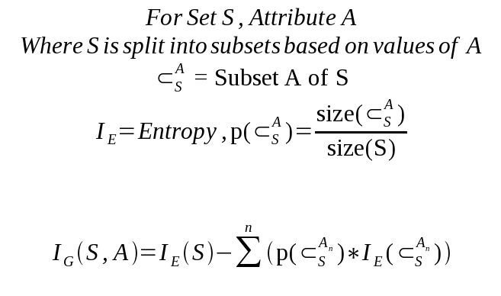
Information Gain

Slide 8

Information Gain
Information Gain for attribute A on set S is defined by taking the entropy of S and subtracting from it the summation of the entropy of each subset of S, determined by values of A, multiplied by each subset’s proportion of S.

Slide 9
ID3 Algorithm
1) Establish Classification Attribute (in Table R)
2) Compute Classification Entropy.
3) For each attribute in R, calculate Information Gain using classification attribute.
4) Select Attribute with the highest gain to be the next Node in the tree (starting from the Root node).
5) Remove Node Attribute, creating reduced table R_{S}.
6) Repeat steps 3-5 until all attributes have been used, or the same classification value remains for all rows in the reduced table.

Slide 10
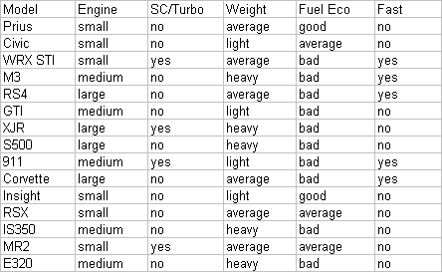
Example

Slide 11
Example
Model Attribute can be tossed out, since its always unique, and it doesn’t help our result.

Slide 12
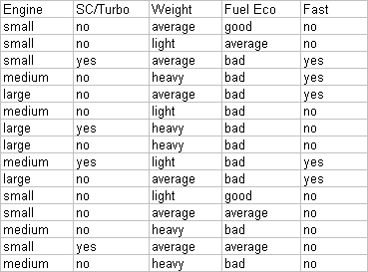
Example
Establish a target classification
Is the car fast?
6/15 yes, 9/15 no

Slide 13
Example – Classification Entropy
Calculating for the Classification Entropy
I_{E}= -(6/15)log₂(6/15)-(9/15)log₂(9/15) = ~0.971
Must calculate Information Gain of remaining attributes to determine the root node.

Slide 14
Example – Information Gain
Engine: 6 small, 5 medium, 4 large
3 values for attribute engine, so we need 3 entropy calculations
small: 5 no, 1 yes | I_{small} = -(5/6)log₂(5/6)-(1/6)log₂(1/6) = ~0.65
medium: 3 no, 2 yes | I_{medium} = -(3/5)log₂(3/5)-(2/5)log₂(2/5) = ~0.97
large: 2 no, 2 yes | I_{large} = 1 (evenly distributed subset)
IG_{Engine} = IE(S) – [(6/15)*I_{small} + (5/15)*I_{medium} + (4/15)*I_{large}]
IG_{Engine} = 0.971 – 0.85 = 0.121

Slide 15
Example – Information Gain
SC/Turbo: 4 yes, 11 no
2 values for attribute SC/Turbo, so we need 2 entropy calculations
yes: 2 yes, 2 no | I_{turbo} = 1 (evenly distributed subset)
no: 3 yes, 8 no | I_{noturbo} = -(3/11)log₂(3/11)-(8/11)log₂(8/11) = ~0.84
IG_{turbo} = IE(S) – [(4/15)*I_{turbo} + (11/15)*I_{noturbo}]
IG_{turbo} = 0.971 – 0.886 = 0.085

Slide 16
Example – Information Gain
Weight: 6 Average, 4 Light, 5 Heavy
3 values for attribute weight, so we need 3 entropy calculations
average: 3 no, 3 yes | I_{average} = 1 (evenly distributed subset)
light: 3 no, 1 yes | I_{light} = -(3/4)log₂(3/4)-(1/4)log₂(1/4) = ~0.81
heavy: 4 no, 1 yes | I_{heavy} = -(4/5)log₂(4/5)-(1/5)log₂(1/5) = ~0.72
IG_{Weight} = IE(S) – [(6/15)*I_{average} + (4/15)*I_{light} + (5/15)*I_{heavy}]
IG_{Weight} = 0.971 – 0.856 = 0.115

Slide 17
Example – Information Gain
Fuel Economy: 2 good, 3 average, 10 bad
3 values for attribute Fuel Eco, so we need 3 entropy calculations
good: 0 yes, 2 no | I_{good} = 0 (no variability)
average: 0 yes, 3 no | I_{average} = 0 (no variability)
bad: 5 yes, 5 no | I_{bad} = 1 (evenly distributed subset)
We can omit calculations for good and average since they always end up not fast.
IG_{FuelEco} = IE(S) – [(10/15)*I_{bad}]
IG_{FuelEco} = 0.971 – 0.667 = 0.304

Slide 18
Example – Choosing the Root Node
Recap:
IG_{Engine} | 0.121
IG_{turbo} | 0.085
IG_{Weight} | 0.115
IG_{FuelEco} | 0.304
Our best pick is Fuel Eco, and we can immediately predict the car is not fast when fuel economy is good or average.

Slide 19
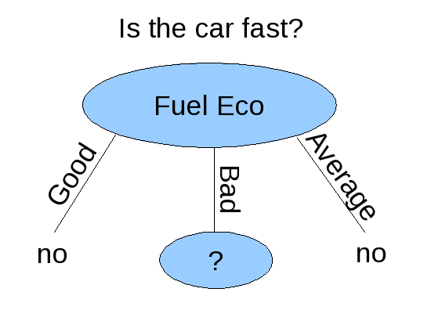
Example – Root of Decision Tree

Slide 20
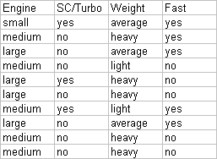
Example – After Root Node Creation
Since we selected the Fuel Eco attribute for our Root Node, it is removed from the table for future calculations.
Calculating for Entropy I_{E}(Fuel Eco) we get 1, since we have 5 yes and 5 no.

Slide 21
Example – Information Gain
Engine: 1 small, 5 medium, 4 large
3 values for attribute engine, so we need 3 entropy calculations
small: 1 yes, 0 no | I_{small} = 0 (no variability)
medium: 2 yes, 3 no | I_{medium} = -(2/5)log₂(2/5)-(3/5)log₂(3/5) = ~0.97
large: 2 no, 2 yes | I_{large} = 1 (evenly distributed subset)
IG_{Engine} = IE(S_{FuelEco}) – (5/10)*I_{medium} + (4/10)*I_{large}]
IG_{Engine} = 1 – 0.885 = 0.115

Slide 22
Example – Information Gain
SC/Turbo: 3 yes, 7 no
2 values for attribute SC/Turbo, so we need 2 entropy calculations
yes: 2 yes, 1 no | I_{turbo} = -(2/3)log₂(2/3)-(1/3)log₂(1/3) = ~0.84
no: 3 yes, 4 no | I_{noturbo} = -(3/7)log₂(3/7)-(4/7)log₂(4/7) = ~0.84
IG_{turbo} = IE(S_{FuelEco}) – [(3/10)*I_{turbo} + (7/10)*I_{noturbo}]
IG_{turbo} = 1 – 0.965 = 0.035

Slide 23
Example – Information Gain
Weight: 3 average, 5 heavy, 2 light
3 values for attribute weight, so we need 3 entropy calculations
average: 3 yes, 0 no | I_{average} = 0 (no variability)
heavy: 1 yes, 4 no | I_{heavy} = -(1/5)log₂(1/5)-(4/5)log₂(4/5) = ~0.72
light: 1 yes, 1 no | I_{light} = 1 (evenly distributed subset)
IG_{Engine} = IE(S_{Fuel Eco}) – [(5/10)*I_{heavy}+(2/10)*I_{light}]
IG_{Engine} = 1 – 0.561 = 0.439

Slide 24
Example – Choosing the Level 2 Node
Recap:
IG_{Engine} | 0.115
IG_{turbo} | 0.035
IG_{Weight} | 0.439
Weight has the highest gain, and is thus the best choice.

Slide 25
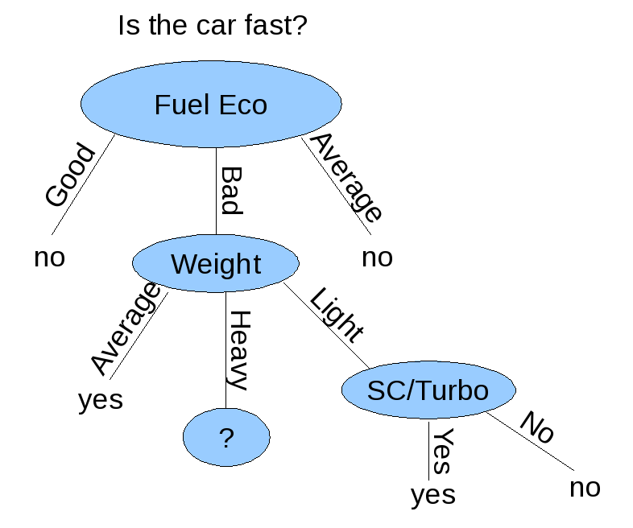
Example – Decision Tree
Since there are only two items for SC/Turbo where Weight = Light, and the result is consistent, we can simplify the weight = Light path.

Slide 26
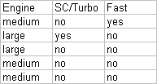
Example – Updated Table
All cars with large engines in this table are not fast.
Due to inconsistent patterns in the data, there is no way to proceed since medium size engines may lead to either fast or not fast.

Slide 27
Closing Notes
ID3 attempts to make the shortest decision tree out of a set of learning data, shortest is not always the best classification.
Requires learning data to have completely consistent patterns with no uncertainty.

Slide 28
References
Quinlan, J. R (1985). Induction of Decision Trees, Machine Learning 1: 81-106, 1986.
Ross, Peter (10/30/2000). Rule Induction: Ross Quinlan’s ID3 Algorithm (Retrieved 04/23/2010). http://www.dcs.napier.ac.uk/~peter/vldb/dm/node11.html
Author Unknown. (Fall 1997). The ID3 Algorithm. Retrieved (Retrieved 04/23/2010). http://www.cise.ufl.edu/~ddd/cap6635/Fall-97/Short-papers/2.htm
Elmasri, Navathe (2007). Fundamentals of Database Systems (5th Edition), 975-977.
Shannon, Claude E. Prediction and Entropy of Printed English. (Retrieved 04/23/2010). http://languagelog.ldc.upenn.edu/myl/Shannon1950.pdf

